Slide 1
Cell Biology Lab Safety
&
Equipment

Slide 2
Lab Safety in Cell Biology
General Safety Rules
Lab Safety in Cell Biology
Biological Safety
Chemical Safety
Sharps & Glassware
Emergency Preparedness

Slide 3


Slide 4
1. General Safety Rules
Wear a lab coat, gloves, and safety goggles at all times.
Tie back long hair and avoid loose clothing/jewelry.
Do not eat, drink, or apply cosmetics in the lab.
Label all reagents, media, and samples properly.
Wash hands before and after lab work.
Know the location of emergency equipment (fire extinguisher, eyewash, shower, first aid kit).

Slide 5

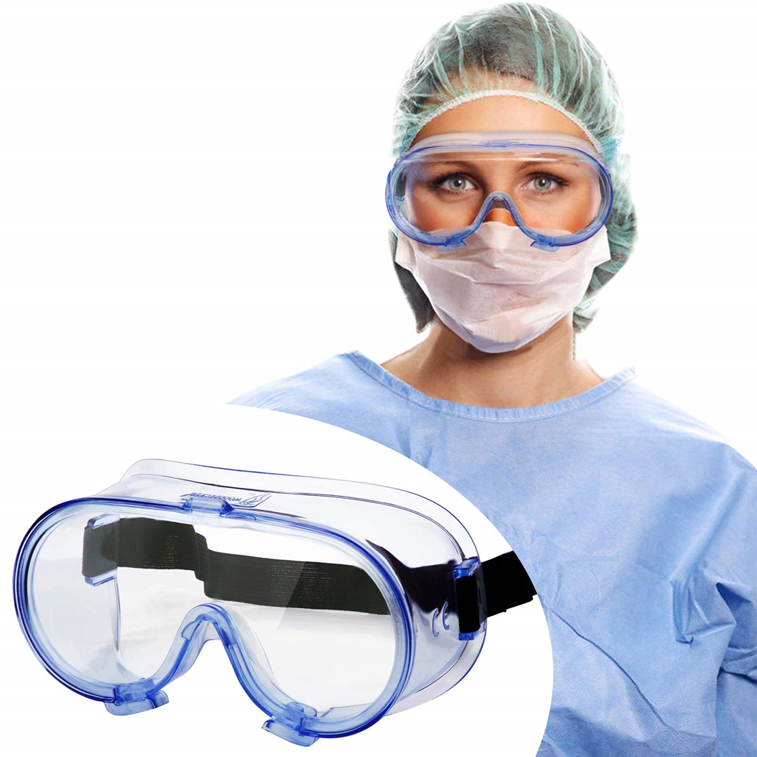
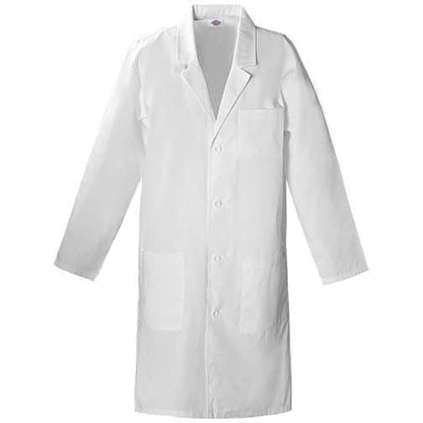
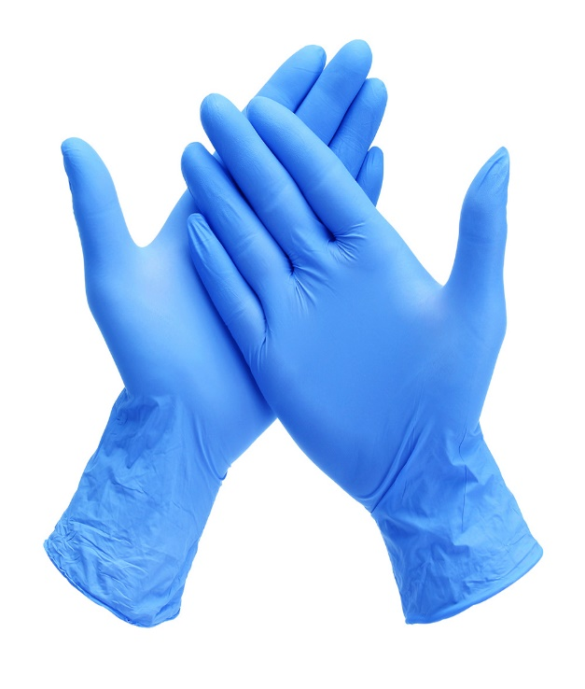
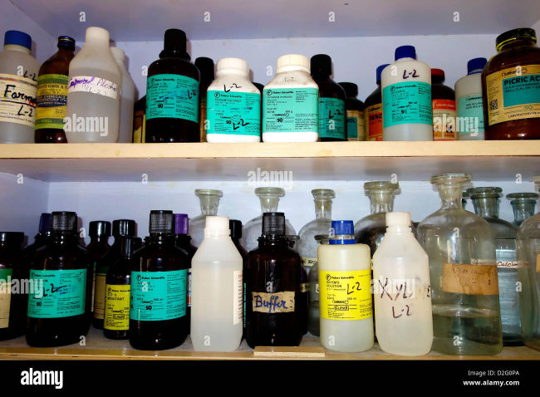
General Safety Rules

Slide 6

2. Biological Safety
Work in a biosafety cabinet (laminar flow hood) when handling cells or microorganisms.
Disinfect surfaces before and after experiments (e.g., with 70% ethanol).
Dispose of biological waste in biohazard containers and autoclave before discarding.
Avoid aerosol generation when pipetting.

Slide 7
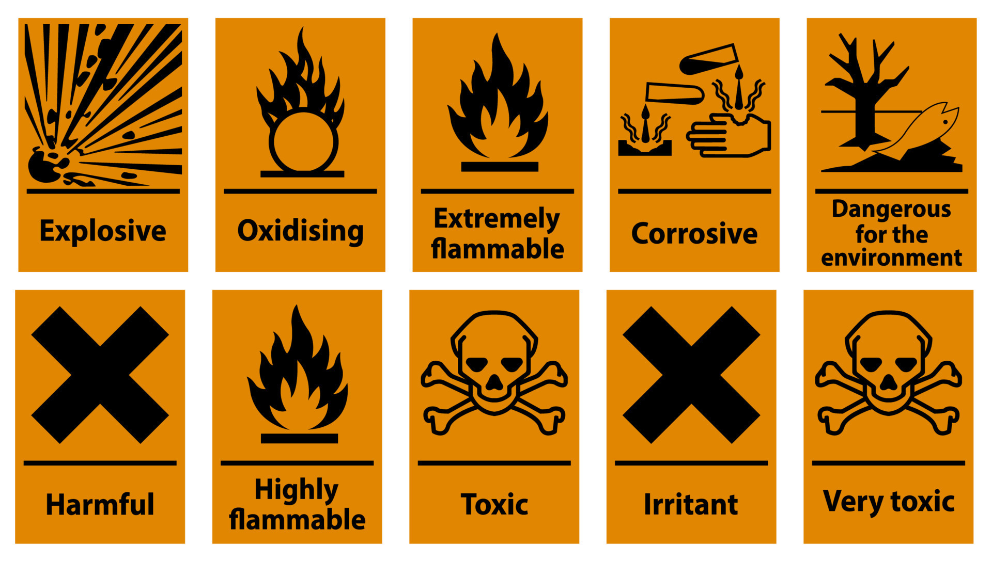
3. Chemical Safety
Handle toxic reagents (e.g., formaldehyde, ethanol, staining dyes) in a fume hood.
Store flammable materials properly in fire-proof cabinets.
Follow MSDS (Material Safety Data Sheets) for each chemical.

Slide 8
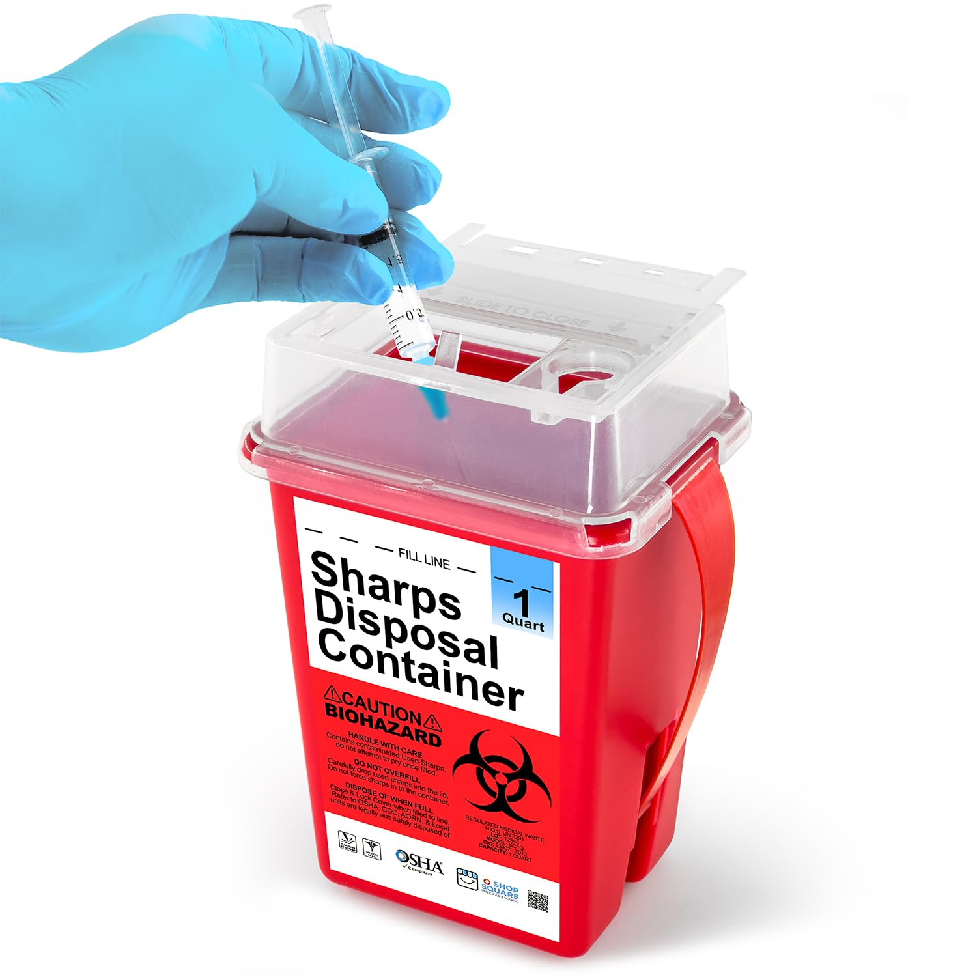
4. Sharps & Glassware
Dispose of needles and blades in sharps containers.
Handle glass pipettes and slides carefully to avoid cuts.

Slide 9
5. Emergency Preparedness
Know spill-cleanup procedures (biological vs. chemical).
Report accidents immediately.
Follow institutional biosafety and chemical safety guidelines.

Slide 10
Microscopy
Basic Lab Equipment
Common Equipment in a Cell Biology Lab
Cell Culture Equipment
Analytical Equipment
Sterilization & Safety Equipment

Slide 11
Microscopy
Microscope (micro- = “small”; -scope = “to look at”) is a tool that produces enlarged images of small objects, thus revealing details too small to be seen by the naked eye.
Types of microscopes:
Microscopes are classified, based on their illumination source, to:
1. Light (Optical) Microscopes.
2. Electron Microscopes.

Slide 12
1. Light (Optical) Microscopes
These use visible light which passes and bends through the lens system to magnify specimens.
They allow for magnification of an object approximately up to 400-1000 times depending on whether the high power or oil immersion objective is used.
Types:
A. Simple Microscopes.
B. Compound Microscopes.
C. Specialized Light Microscopes.

Slide 13
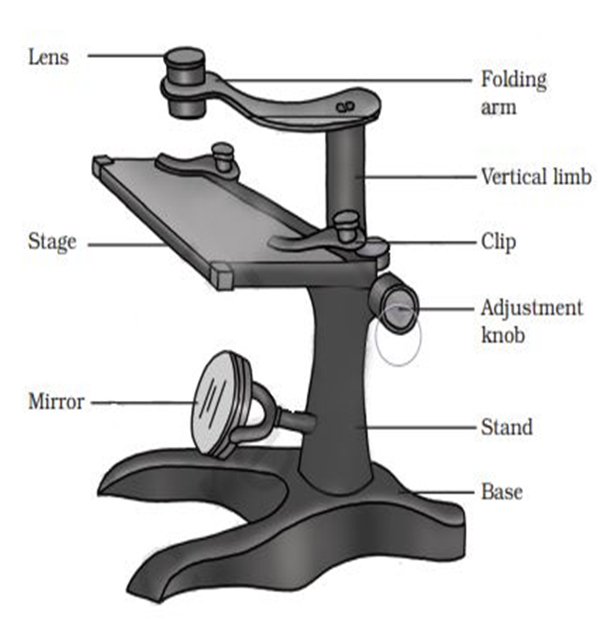
A. Simple Microscopes:
Use a single lens for magnification (e.g., magnifying glass).
provide a moderate level of magnification.
Typically have a magnifying power ranging from 10x to 100x.

Slide 14
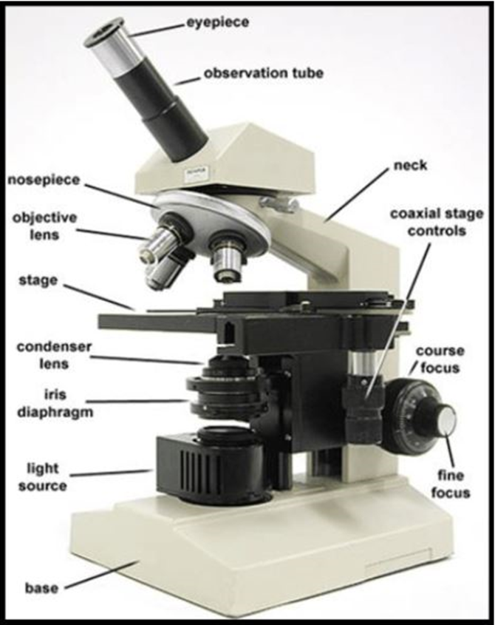
B. Compound Microscopes:
Employ two sets of lenses (objective and eyepiece) to achieve higher magnification.
A compound microscope's magnifying power is determined by multiplying the magnification of the objective lens by the magnification of the eyepiece lens.
Typical compound microscopes can achieve magnifications ranging from 40x to 1000x, using objective lenses with magnifications like 4x, 10x, 40x, and 100x, combined with a 10x eyepiece.

Slide 15
C. Specialized Light Microscopes
These are designed to enhance specific aspects of image quality or to visualize samples in unique ways that standard light microscopes cannot.
Include phase contrast and fluorescence microscopes, each using different light properties to visualize specific sample features.
Examples:
I. Phase contrast microscopes.
II. Fluorescence microscopes.

Slide 16
I. Phase contrast microscopes:
Used for the examination of unstained specimens.
Unstained living cells absorb practically no light, poor light absorption results in extremely small differences in the intensity distribution in the image.
This makes the cells barely, or not at all, visible in a bright field microscope.
Phase-contrast microscopy is an optical microscopy technique that converts phase shifts in the light passing through a transparent specimen to brightness changes in the image.

Slide 17
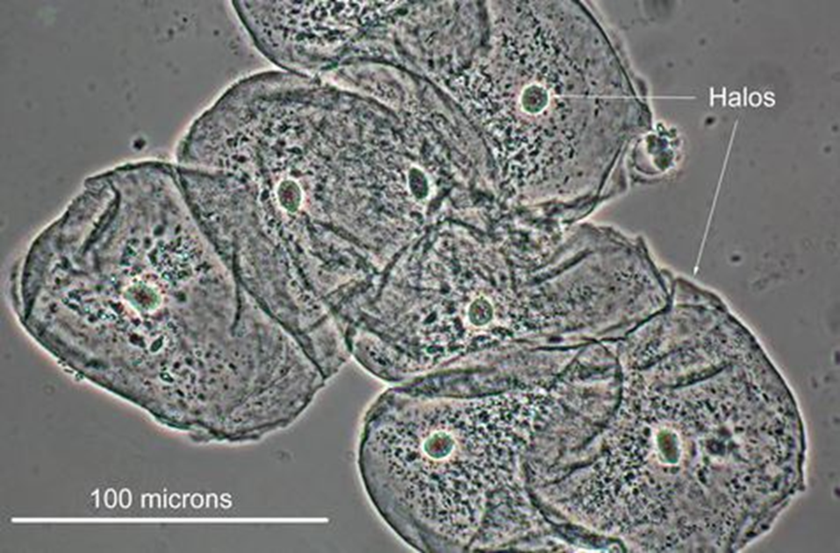
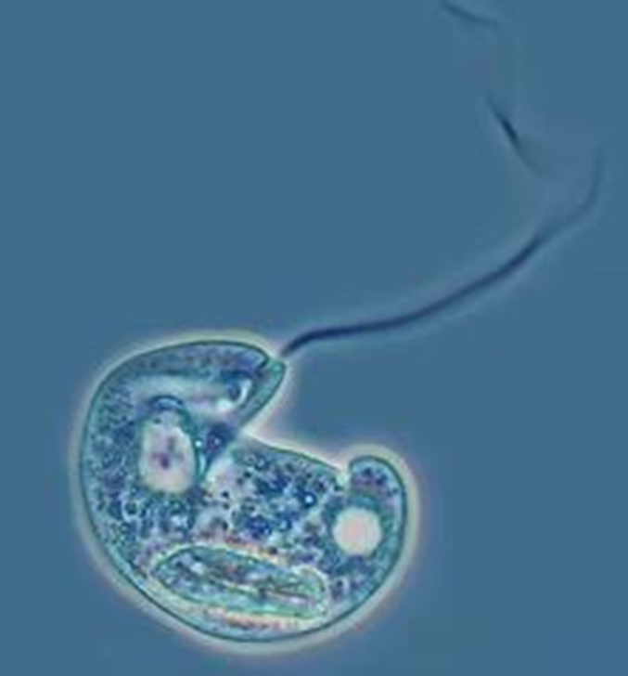
I. Phase contrast microscopes:
Human cheek cells photographed with phase contrast microscope
Euglena sp. photographed with phase contrast microscope

Slide 18
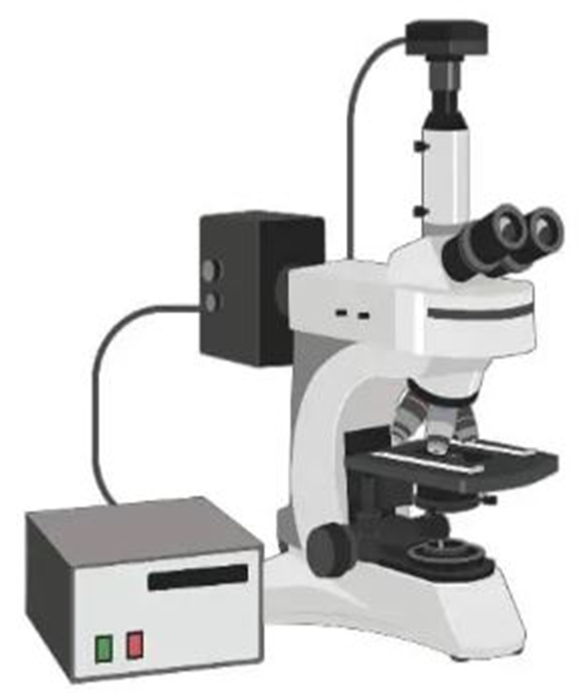
II. Fluorescence microscopes:
Fluorescence microscopy utilizes fluorophores, or fluorescent dyes, to stain specimens, allowing for visualization of specific cellular components under a microscope by using an ultraviolet light source.
These fluorophores (fluorochromes) absorb light at a specific wavelength (excitation wavelength), usually UV, and then emit light at a longer, lower-energy wavelength (emission wavelength), creating a bright image against a dark background.
This technique is valuable for studying various biological processes and visualizing specific structures within cells and tissues.
Common fluorescent dyes include fluorescein and rhodamine.

Slide 19
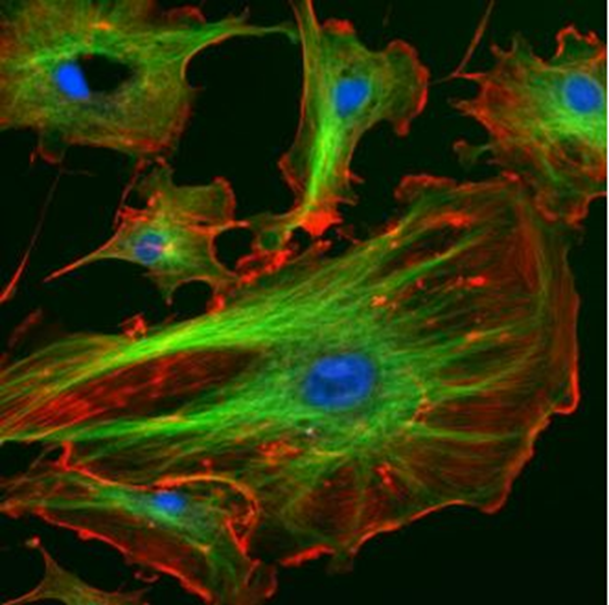
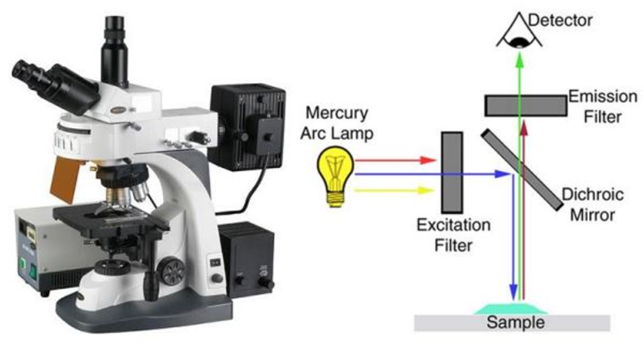
II. Fluorescence microscopes:
Fluorescent cells: Fixed endothelial cells stained with fluorescent dyes.

Slide 20
2. Electron Microscopes (EM) :
These use a beam of electrons instead of light to create images.
EMs offer significantly higher magnification and resolution compared to optical microscopes, enabling the visualization of structures at the nanoscale.
Electron microscopes can resolve features that are millions of times smaller than those visible with light microscopes, achieving magnifications of up to 1,000,000x.
The final image is typically projected onto a fluorescent screen which is coated with a material that emits light when struck by electrons, making the image visible.
Types:
A. Transmission Electron Microscopes.
B. Scanning Electron Microscopes.

Slide 21
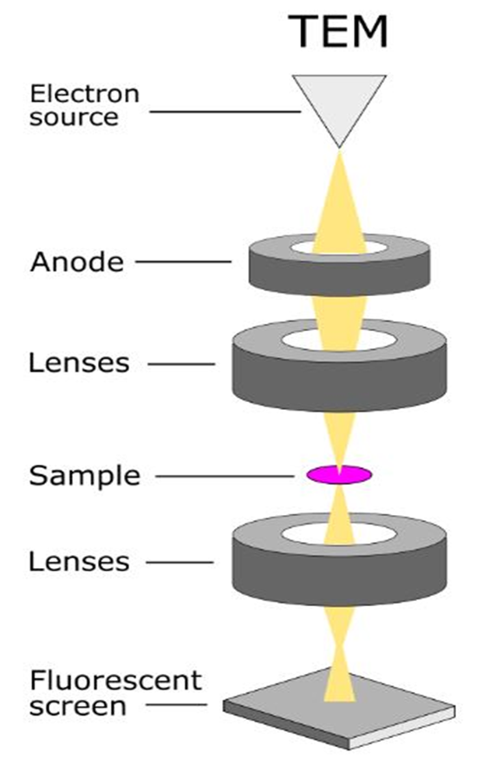
A. Transmission Electron Microscopes (TEM):
In TEM, a beam of electrons is transmitted through a very thin specimen.
The electrons that pass through the specimen are used to form an image, revealing the internal structure of the sample.
TEMs are analogous to compound light microscopes and are often used to view thin sections of cells, molecules, and other materials.

Slide 22

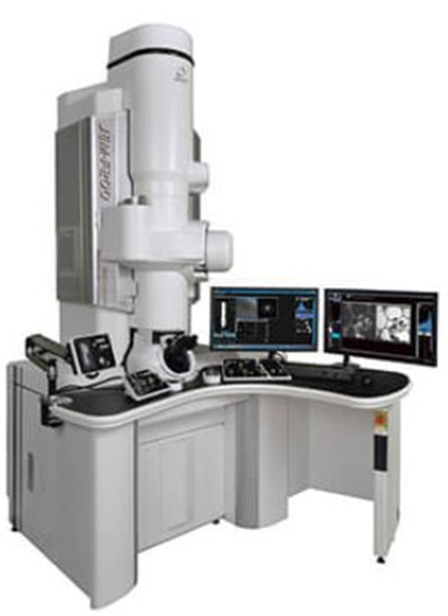
A. Transmission Electron Microscopes (TEM):

Slide 23
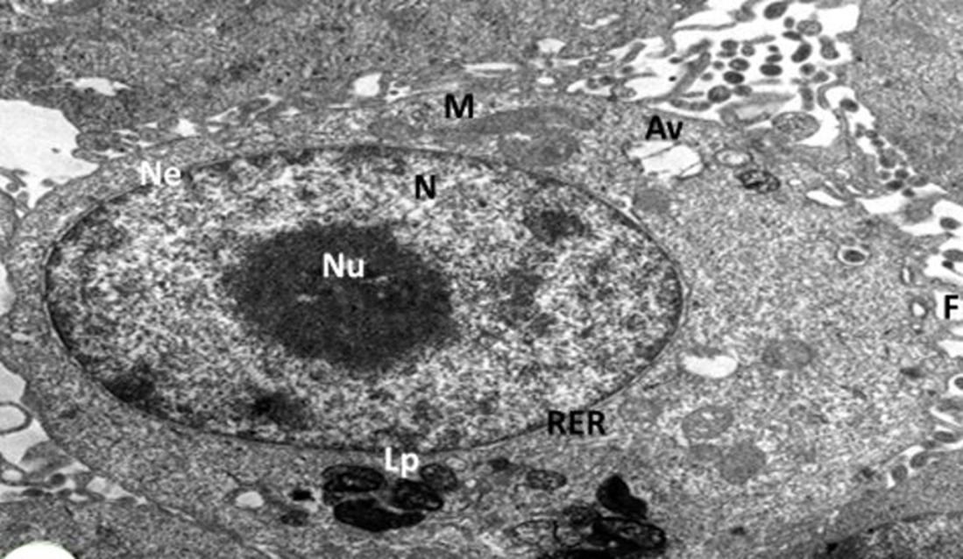
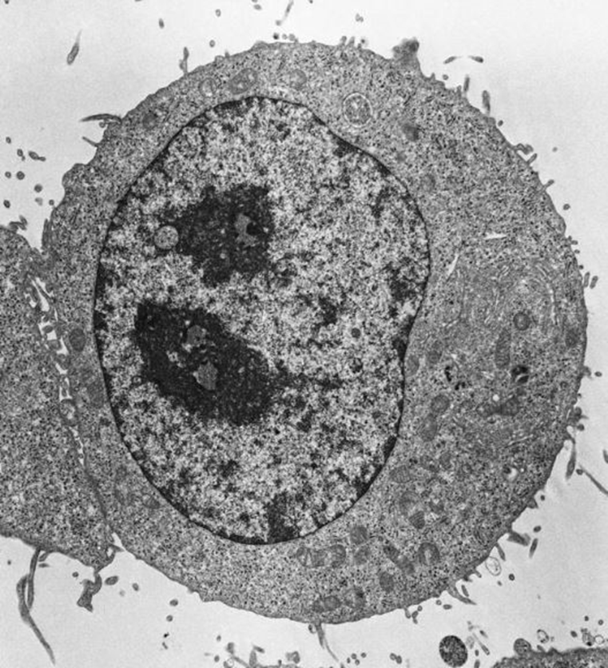
A. Transmission Electron Microscopes (TEM):

Slide 24
B. Scanning Electron Microscopes (SEM):
SEM uses a focused electron beam to scan the surface of a specimen.
The electrons that are scattered or emitted from the surface are detected, creating an image that reveals the sample's surface topography and composition.
It is a powerful tool that is capable of producing high-resolution 3D images of a wide range of samples.
Samples are prepared for analysis by applying a thin, conductive layer, typically of gold or other metals on their surface for coating.
This coating prevents charge buildup (charging) from the electron beam and improves signal detection, resulting in clearer, more accurate images.
SEMs are often used to examine the surface features of samples.

Slide 25
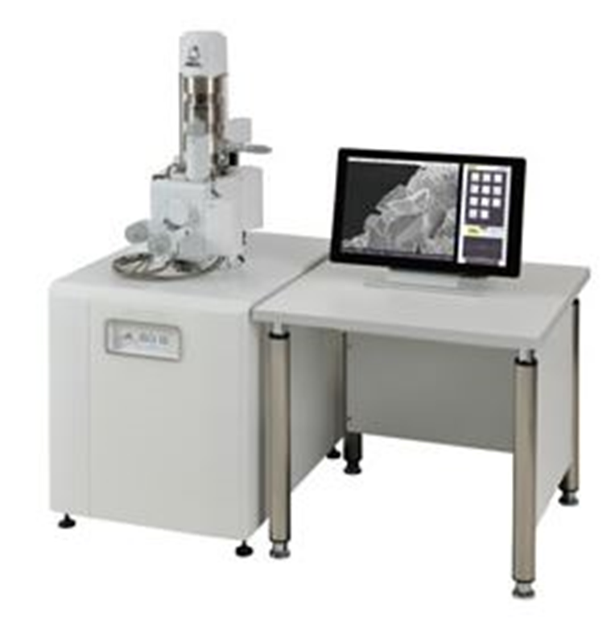
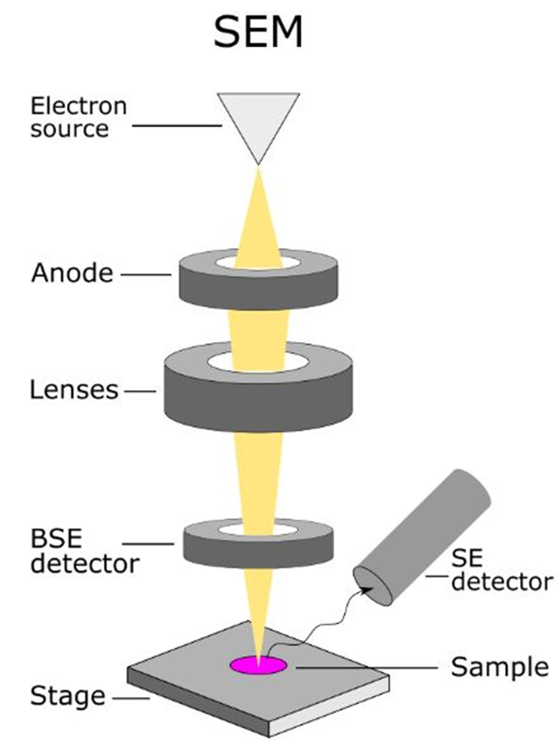
B. Scanning Electron Microscopes (SEM):

Slide 26
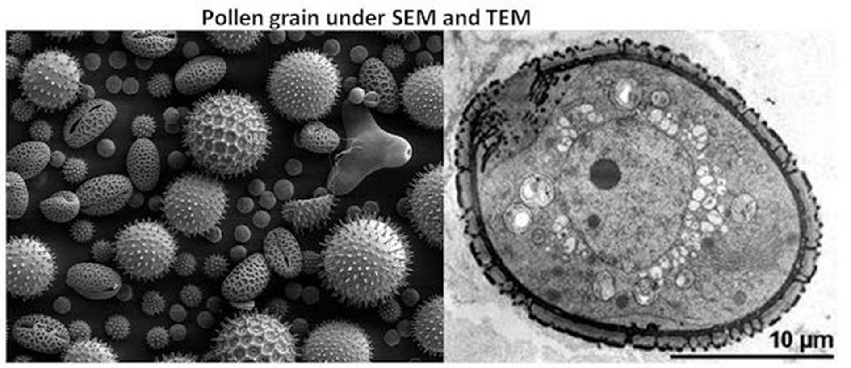

Slide 27
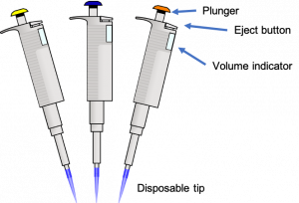
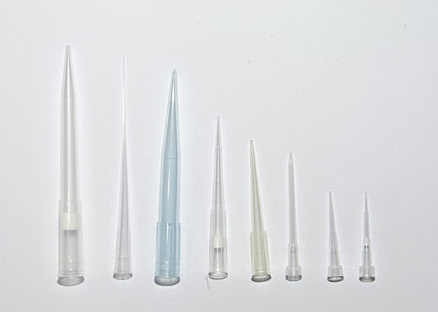
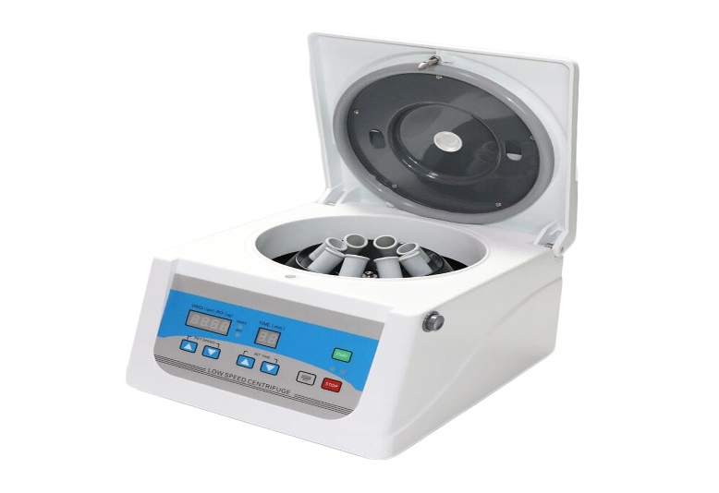
1. Basic Lab Equipment
Micropipettes & tips
- for precise liquid handling.
Centrifuge
- separates cells and biomolecules by density.

Slide 28
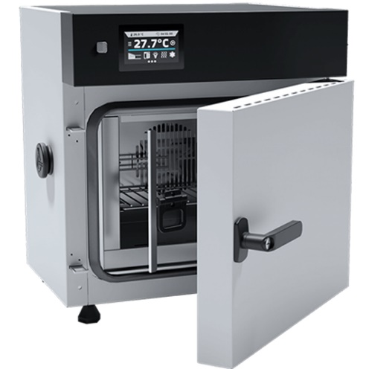
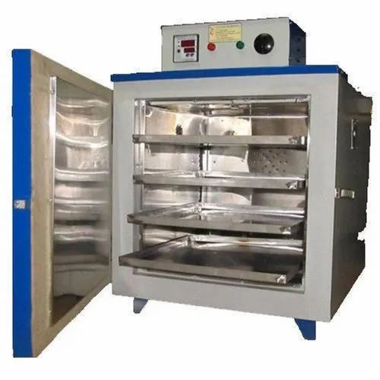
- Incubator (CO₂ incubator)
maintains temperature, humidity, and CO₂ for cell culture.
Hot air oven
- for dry sterilization of glassware.

Slide 29
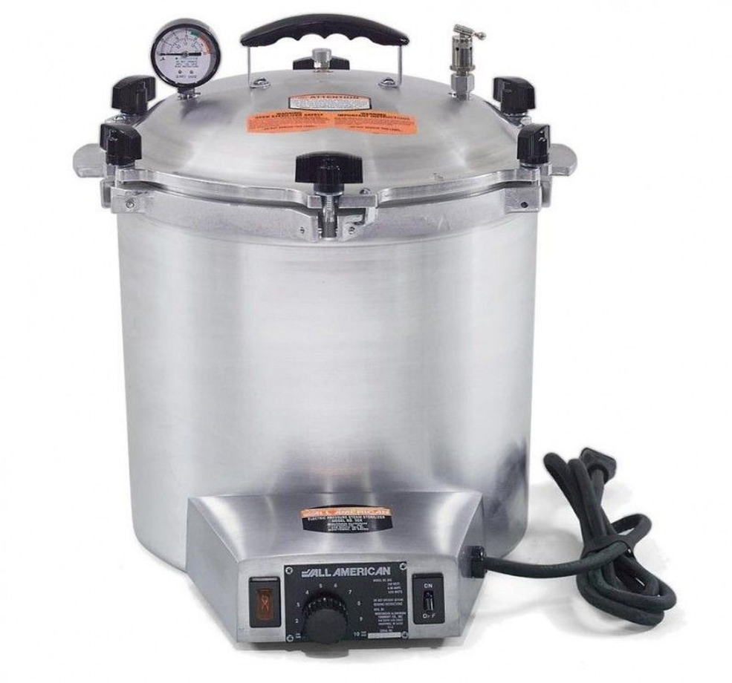
Autoclave
-steam sterilization of media, glassware, and waste.

Slide 30
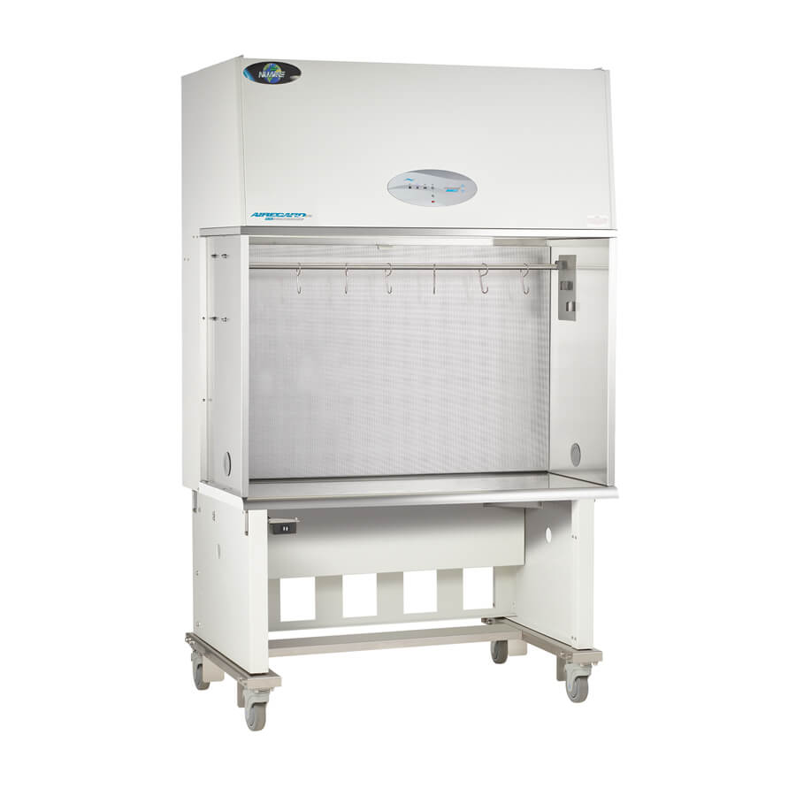
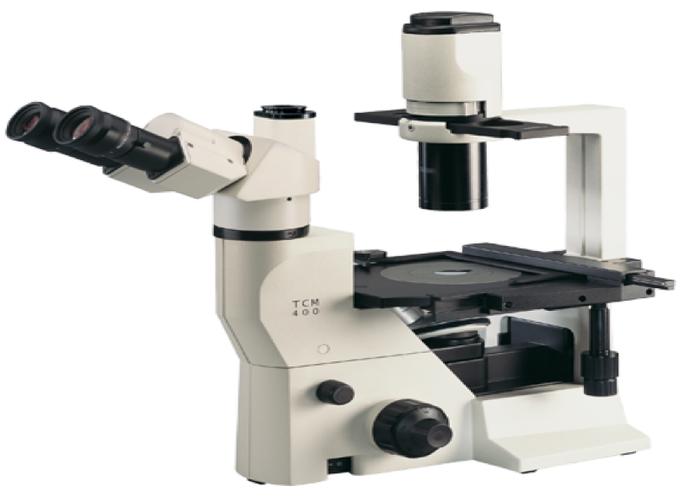
2. Cell Culture Equipment
Laminar flow hood / Biosafety cabinet
-sterile environment for handling cells.
Inverted microscope
-observing cells in culture flasks/dishes.

Slide 31
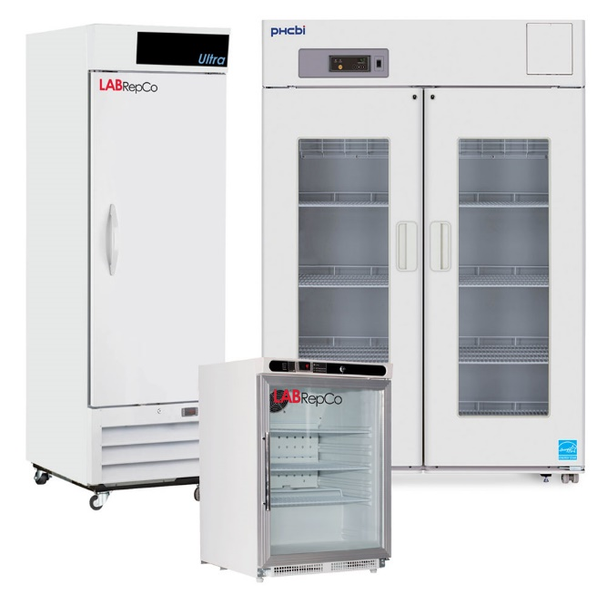
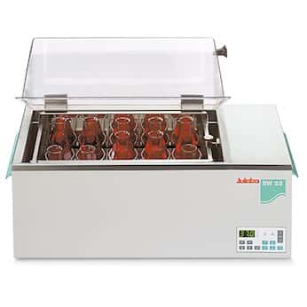
Refrigerators & -20°C / -80°C freezers
- storing reagents, enzymes, and samples.
Shakers & water baths
- mixing and maintaining temperature for cultures/reagents.

Slide 32
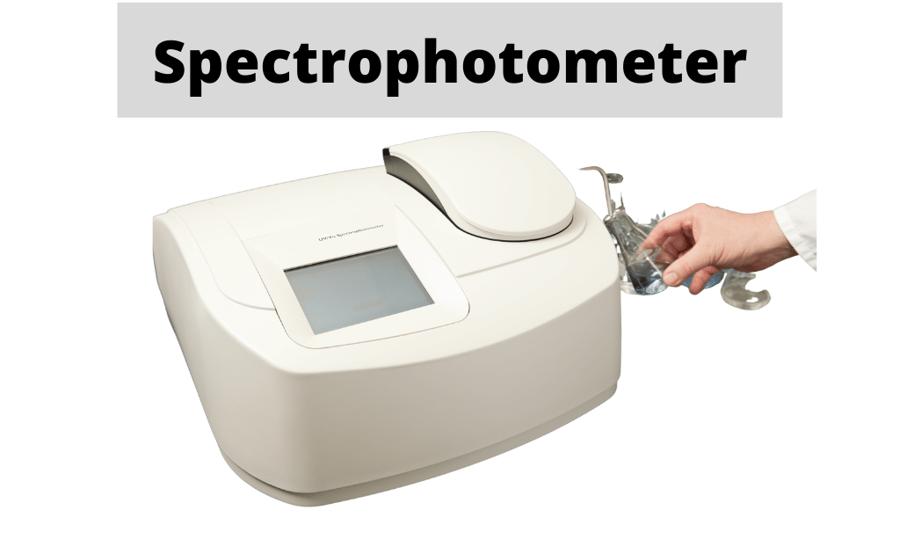
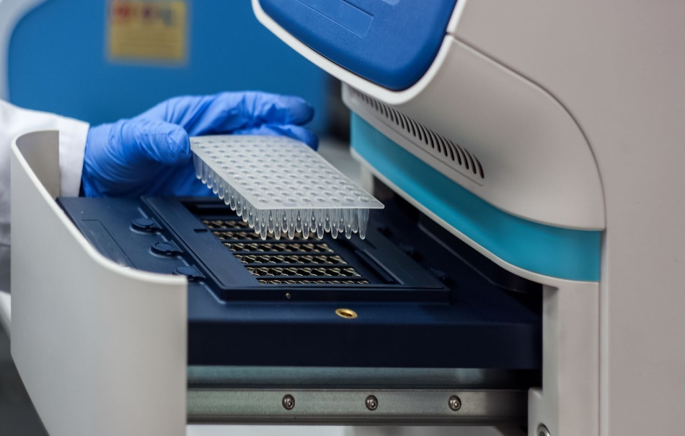
3. Analytical Equipment
Spectrophotometer / Nanodrop
- measuring nucleic acids, proteins, and cell density.
Western blot, PCR, electrophoresis units
-for molecular studies in cell biology.

Slide 33
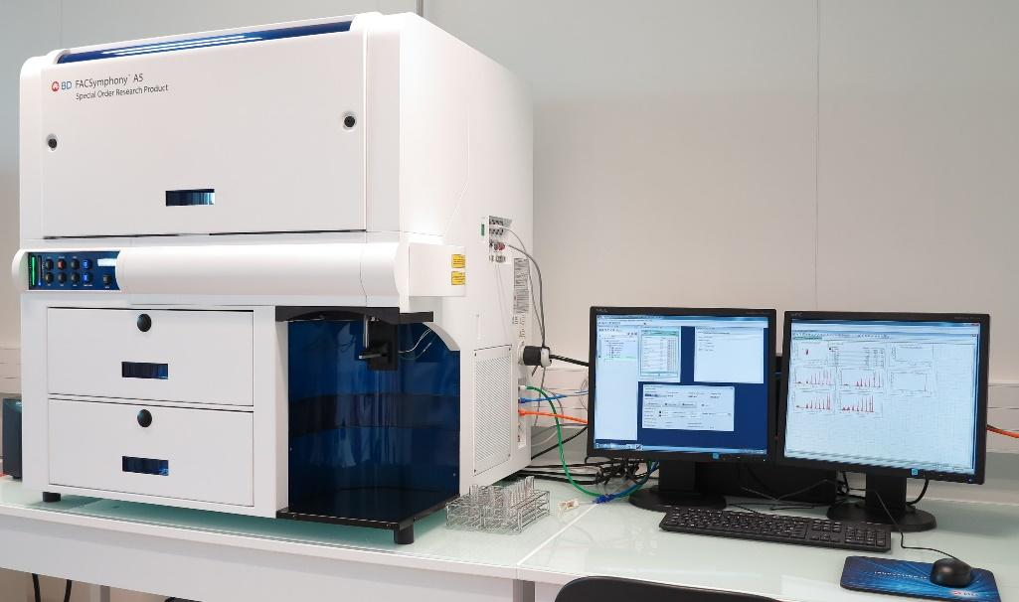
Flow cytometer
- analyzing cell populations.

Slide 34

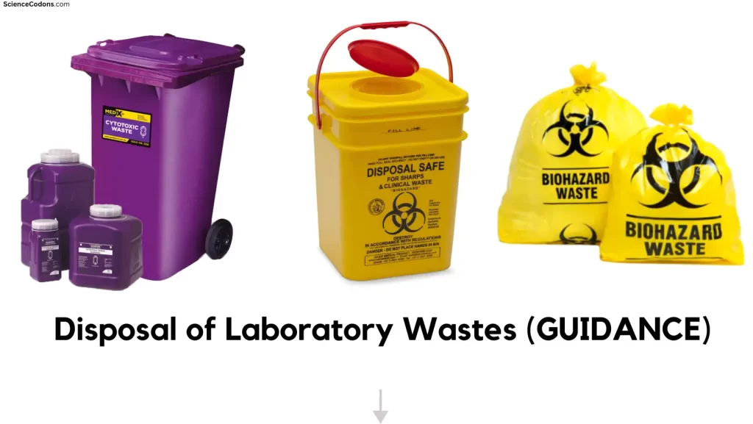
4. Sterilization & Safety Equipment
UV sterilizer
-surface sterilization of tools and cabinets.
Waste disposal bins
- separate for biohazard, sharps, and chemicals.

Slide 35


Eyewash stations & fire extinguishers
- for emergencies.

Slide 36
THANKS

